Slide 1


K.RAMAKRISHNAN COLLEGE OF ENGINEERING
(Autonomous)
Accredited by NAAC with - 'A' Grade, NBA Accreditation of EEE
DEPARTMENT OF ELRCTRICAL AND ELECTRONICS ENGINEERING
BATCH NO :05
SOLAR WIRELESS ELECTRIC VEHICLE CHARGING SYSTEM
GUIDED BY
Mrs.A.DURGADEVI
ASSISTANT PROFESSOR
Electrical and Electronics Engineering
K Ramakrishnan College of Engineering,
(Autonomous)
Samaya Puram, Tiruchirappalli – 621 112

Slide 2
PRESENTED BY
MANIKKADEEPAN K - EE2127
NAVANEETHRAJ S - EE2131
SARAN A - EE2141
SIVAPRAKASAM M- EE2144

Slide 3
INTRODUCTION
Wireless Electricity Transfer or WET is a process to supply power through an air gap without using any wire or physical link.
Its uses electromagnetic field to transfer energy from the charging
System to the vehicles battery ,without the need for physical cables.
The system makes use of a solar panel,battery,transformer ,regulator circuitry ,copper coils ,AC to DC converter, MQ-2 gas sensor,ESP8266.

Slide 4
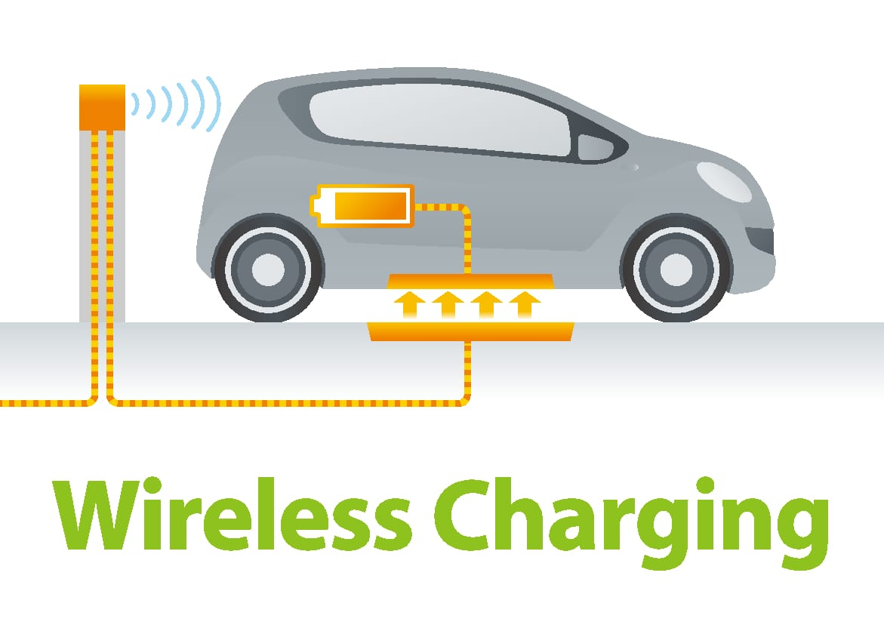
ABSTRACT
One cannot imagine world without electricity, the electricity is transmitted through wires.
Wireless charging is a technology of transmitting power through an air gap to electrical devices for the purpose of energy replenishment. The Wireless power transmission concept is not new.
Its was first demonstrated by NIKOLA TESLA in the year 1890.

Slide 5
OBJECTIVE OF THE STUDY
To make a portable machine with the use of battery as a power .
Low cost as compare to existing operating machine .
Wireless charging vehicle mechanism will continue to play a significant role. Present mobility are complicated using number of wheels.
The system demonstrates how electric vehicles can be charged while moving on road, eliminating the need to stop for charging.
Six wheels rovers are capable of navigating rough terrain using an effective high degree of mobility suspension system. Drive train ease fundamental mechanical feature of the wireless vehicle design.

Slide 6
METHODOLOGY
Wireless charging vehicle Mechanism will continue to play a signific can’t role.
The fundamental idea behind IPT is that by rung an alternating current through a coil, a magnetic field is created .
Another coil that is close to the first coil experiences a current due to this magnetic field
Six wheeled rovers are capable of navigating rough terrain using an effective high degree of mobility suspension system.
Inside the body where thermal deviation is kept to a lowest ,both motors are located is responsible for increasing reliability and efficiency.
A series of mobility experiments in the uneven roads, agricultural land , inclined stairs , defficult surfaces.

Slide 7
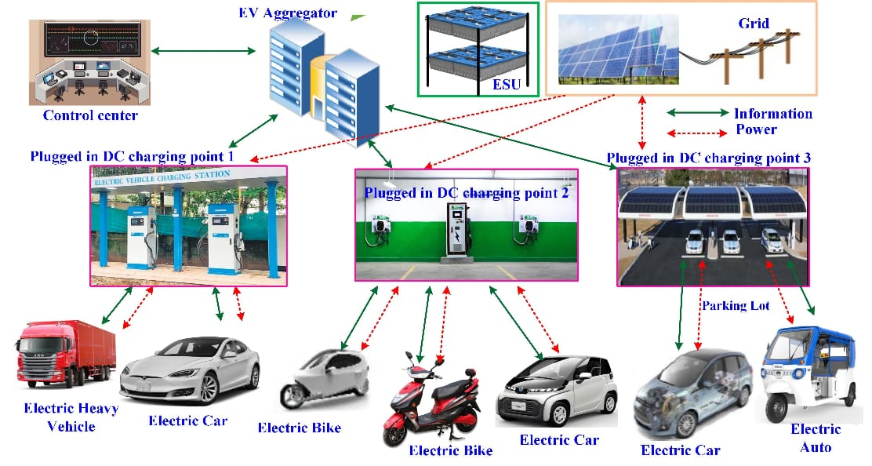
WIRE CONNECTION

Slide 8
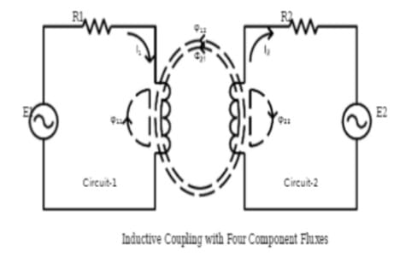
WIRE LESS CHARGING ????

Slide 9
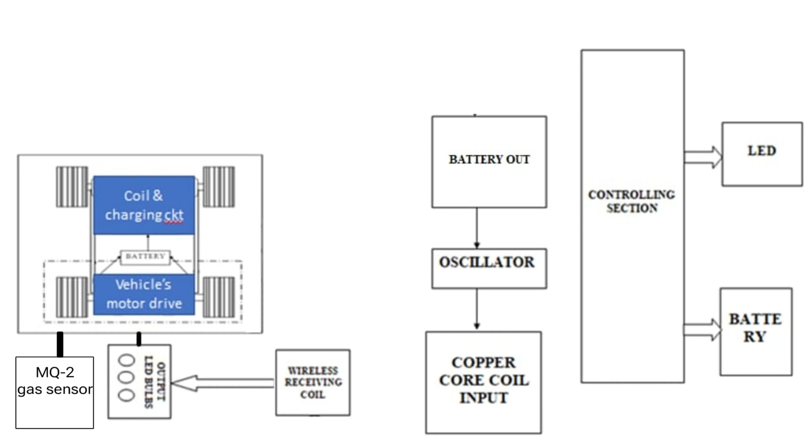
BLOCK DIAGRAM

Slide 10
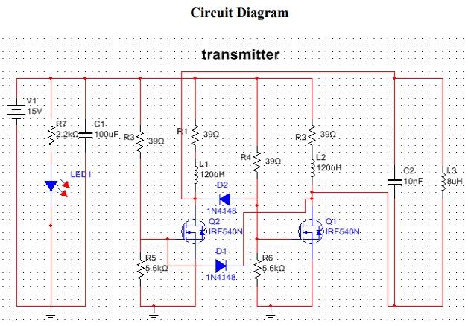
CIRCUIT DIAGRAM

Slide 11
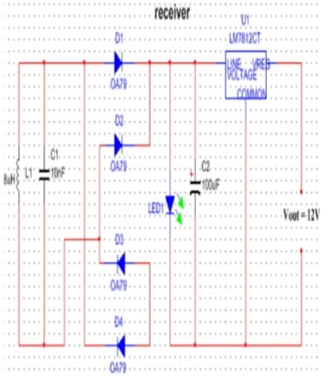
CIRCUIT DIAGRAM

Slide 12
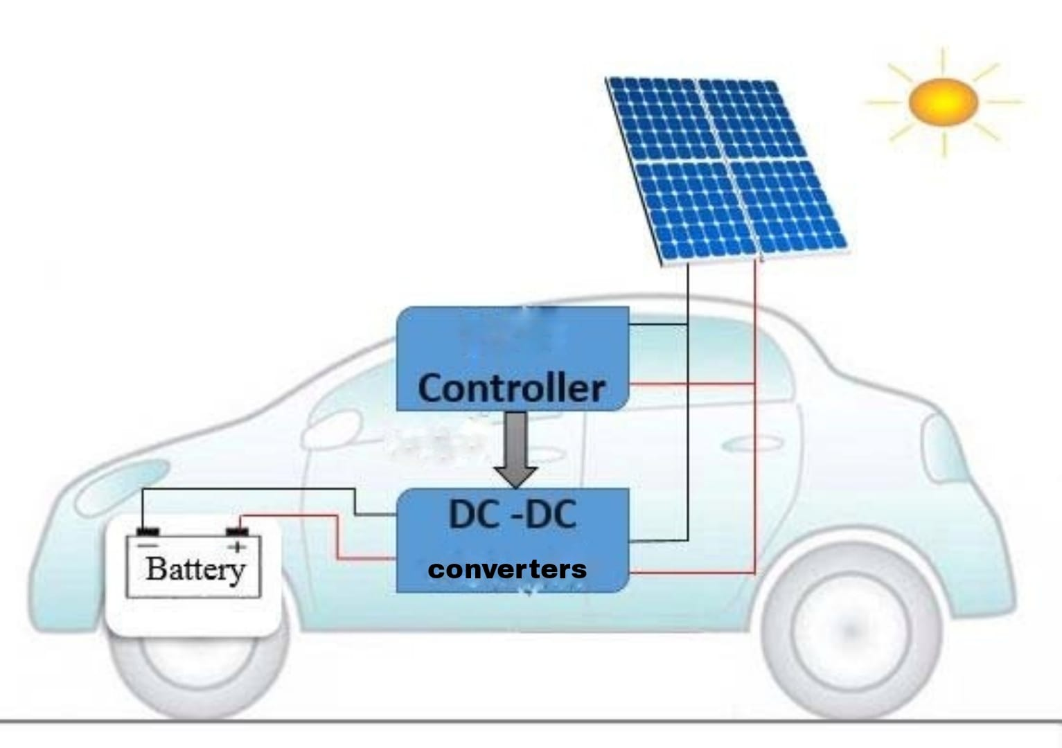
WIRELESS CONNECTION

Slide 13
COMPONENT
SNO | PARTICULARS | QUANTITY
1 | Induction coil | 1set
2 | Battery | 2
3 | Controller ckt | 1 set
4 | Model car | 1
5 | Regulator ckt | 2
6 | Miscellaneous | -
7 | AC to DC convertor | 1
8 | DC to AC convertor | 1
9 | Base plate | 1
10 | MQ-2 gas sensor,ESP8266 | 1

Slide 14
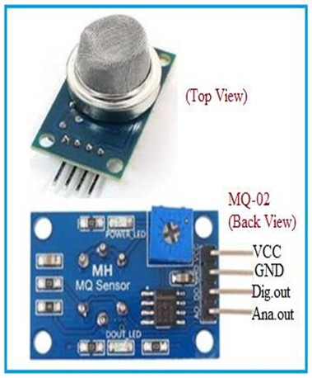
MQ-2 GAS SENSOR
The MQ-2 gas sensor is a popular module for detecting various types of gases such as LPG, propane, hydrogen, methane, and alcohol vapor in the air. It's widely used in gas leakage detection systems, fire detection systems, and battery protection.

Slide 15
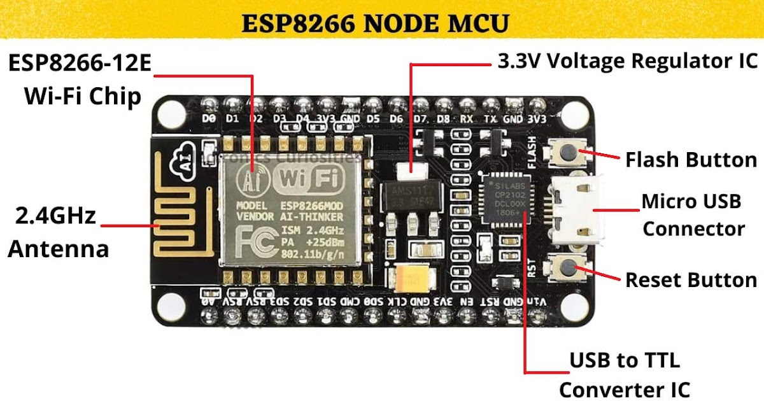
ESP8266

Slide 16
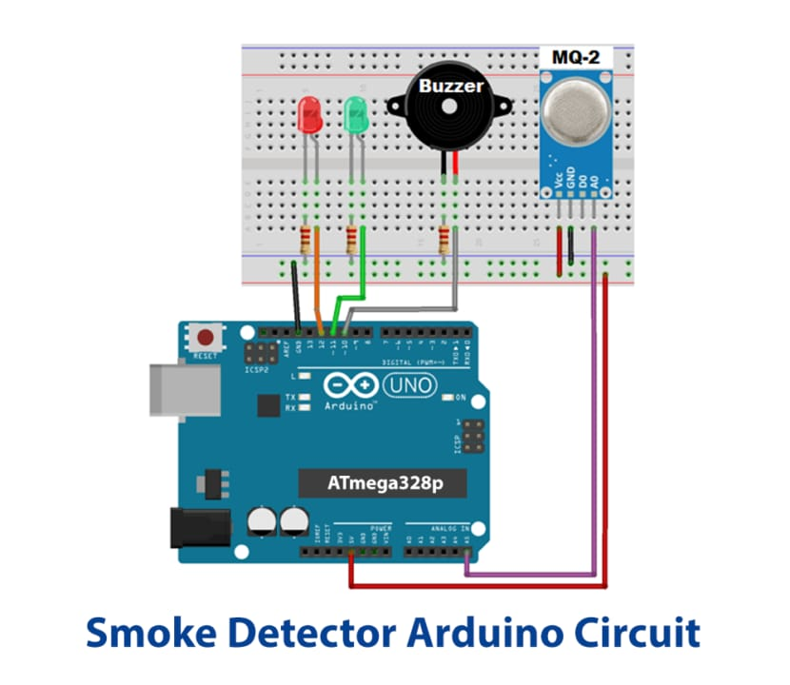
BATTERY PRODUCTION SENSOR CIRCUIT

Slide 17
WORKING PRINCIPLE
Both the circuits are constructed on the breadboard and powered using a 1.5V battery. The circuit can’t be used for more than 1.5 volt power supply as transistor may heat up for excessive power dissipation.
This wireless electricity transmission is based on the Inductive coupling technique. The circuit consists of two parts- Transmitter and Receiver.
In transmitter section, the solar panel generating high-frequency DC current to charge the battery of base, across the coil and the coil is generating a magnetic field around it. As the coil is center tapped, the two sides of the coil start to charge up.

Slide 18
WORKING PRINCIPLE
One side of the coil is connected to the resistor and another side is connected to the collector terminal of NPN transistor. During the charging condition, the base resistor starts to conduct which eventually turns on the transistor.
The transistor then discharges the inductor as the emitter is connected with the ground. This charging and discharging of the inductor produces a very high frequency oscillation signal which is further transmitted as a magnetic field.
On the receiver side, that magnetic field is transferred into the other coil, and by the Faraday’s law of induction, the receiver coil start producing EMF voltage which is further used to light up the LED.

Slide 19
PROGRAM
#define BUZZER_PIN D8
#include <ESP8266WiFi.h>
#define LED_PIN D7
const int gasSensorPin = A0;
// Analog input pin for gas sensor
void setup() {
Serial.begin(9600);
pinMode(gasSensorPin, INPUT);
pinMode(BUZZER_PIN, OUTPUT);// Set gas sensor pin as input
pinMode(LED_PIN, OUTPUT);
}

Slide 20
PROGRAM
void loop() {
// Read analog value from gas sensor
int sensorValue = analog Read(gasSensorPin);
// Print sensor value
Serial.print("Gas Sensor Value: ");
Serial.println(sensorValue);
if(sensorValue>50){
digital Write(BUZZER_PIN, HIGH);
digital Write(LED_PIN, HIGH);
Serial.print("YOUR BATTERY WAS DEMAGED");}

Slide 21
PROGRAM
else{
digital Write(BUZZER_PIN, LOW);
digital Write(LED_PIN, LOW);
Serial.print("YOUR BATTERY WAS NORMAL");
}
delay(1000); // Delay between readings
}

Slide 22
ADVANTAGES
Single type capacitor is used to control the power factor (not capacitor bank). Totally 2 capacitor is used. (this unit is capable of controlling the PF of 500 Watt only.
Power factor is the ratio between the KW and the KVA drawn by an electrical load
where the KW is the actual load power and the KVA is the apparent load power.

Slide 23
DISADVANTAGES
The Charging wirelessly is more time-consuming.
Wireless charging is one area that is always being upgraded.
Still, it can't compete with the speed of cable charging.
The process of wirelessly transferring power generates more heat than wired charging, which can cause the battery to degrade faster.

Slide 24
APPLICATION
Wireless power transfer (WPT) is a widely discussed topic in the electronics industry.
This technology is growing rapidly in the consumer electronics market for smartphones and chargers.
There are countless benefits of WPT.
Firstly, in modern power requirement area, WPT can eliminate the traditional charging system by replacing the wired charging solutions

Slide 25
CONCLUSION
According to this technique, charging electric vehicles can be done while moving along and not at a charging station.
Therefore ,the technology supports the feasibility of a wireless, road-integrated ,solar-power EV charging system.
Wireless charging technology is reshaping the way we power our devices, providing a seamless and convenient charging experience.

Slide 26
DRAWBACK
Lower Efficiency:
Wireless charging systems typically experience lower efficiency than traditional wired charging due to energy losses during induction.
This could lead to longer charging times and slightly higher energy consumption.

Slide 27
REFERENCES
1. 1. Ram vara prasad, bugatha & geethanjali, m & sonia, m & ganeesh, s & krishna
(2022).Solar wirelesselectric vehicle charging system. Interantional journal of scientific research inengineering and management. 06. 10.55041/ijsrem14449.
2.Ram vara prasad, bugatha & deepthi, t. (2021). Singh, sagolsem & hasarmani, totappa & holmukhe, rajesh. (2012). Wireless transmission of electricalpower overview of recent research & development. International journal ofcomputer and electricalengineering. 207-211. 10.7763/ijcee.2012.v4.480

Slide 28
VIDEO LINK
Videolink:https://drive.google.com/file/d/1l8ss0FMeLaNFRe0DgAkPgC5vGVfAmGuX/view?usp=drivesdk
https://drive.google.com/file/d/1l90iO_r09UgTm09-YeDCExUq4An28dvF/view?usp=drivesdk

Slide 29


